Slide 1
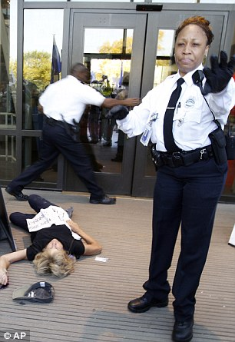
Security Guard
Chase Gosse

Slide 2
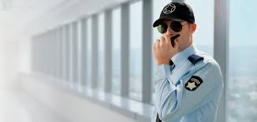
The gist of the job
Protecting property and or persons of value during any time of the day using non/violence and intimidation doing so with weapons/strength and sometimes making citizens arrests.

Slide 3
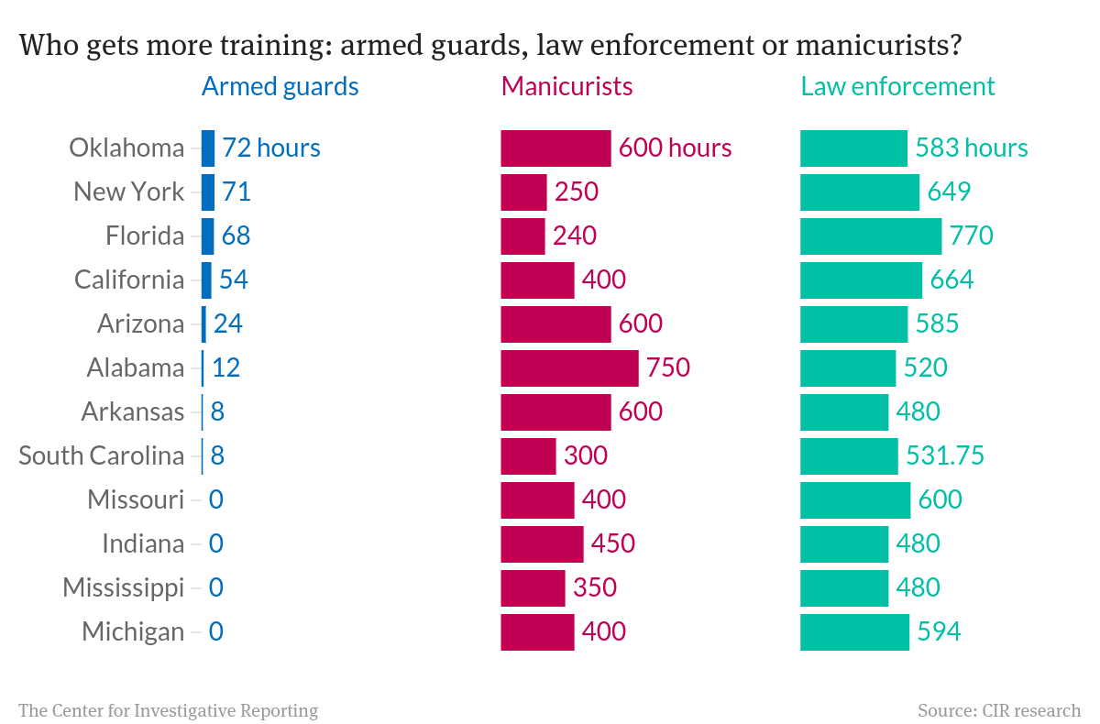

Slide 4
